Slide 1
Interrupts

Slide 2

Process Control Block
Represents a process in the OS – Containing information about the process
Process State (Ready, Running, Waiting, etc.)
Process Counter (Address of next instructions)
CPU Registers (Accumulators, Index Register, Stack Pointer)
CPU Scheduling information (Process Priority)
Memory management information (Base and Limit Register)
Accounting Information (CPU time used, time limit, etc.)
I/O Status Information (I/O Devices allocated to the process)
The base register contains the lowest address allocated to P. The limit register contains the number of bytes in the allocation. Using the values in the base and limit registers, hardware checks every address generated in user mode. Any attempt in user mode to access memory out of bounds results in a trap.
Accumulator is a type of register for short-term, intermediate storage of arithmetic and logic data in a computer's central processing unit (CPU)
Notes:
2

Slide 3
Process States
As a process executes, its state is changed based on its current activity
New: Process is being created
Running: Instructions are being executed
Waiting: The process is waiting for some event to occur (such as an I/O completion or reception of any signal)
Ready: The process is waiting to be assigned to a processor
Terminated: The process has finished execution
Notes:
3

Slide 4
Process States
TERMINATED
NEW
Process created
Process Terminated
Interrupt
READY
RUNNING
Scheduler dispatch
WAITING
I/O or Event completion
I/O or Event wait
Notes:
4

Slide 5
Interrupts
Notes:
5

Slide 6
Interrupts
Processes can be interrupted by several events. Taking the example of an I/O device transferring data, the process is as follows:
When an I/O device is ready to transfer data, an interrupt request (IRQ) is created
The main program is interrupted and suspended.
The CPU execution jumps to the ISR (Interrupt Service Routine) or Interrupt Handler
When ISR completes handling, returns to previously suspended process
Notes:
6

Slide 7
Interrupts
OS
Privilege
User Process
User Process
Event
Time
Notes:
7

Slide 8
Types of Events
Hardware interrupts
Raised by hardware devices
Asynchronous
Traps
Software interrupts
Raised by user program to invoke an OS functionality
Exceptions
Generated automatically by the processor itself as a result of an illegal instruction
Faults: recoverable errors(page faults)
Aborts: difficult to recover(divide by zero)
Notes:
8

Slide 9
Types of Events
An efficient I/O system uses both hardware and software for handling I/O events
The CPU is left to continuously execute tasks
Only responds to I/O devices when the I/O device requests
Notes:
9

Slide 10
Interrupts
Processes can be interrupted by several events. Taking the example of an I/O device transferring data, the process is as follows:
When an I/O device is ready to transfer data, an interrupt request (IRQ) is created
The main program is interrupted and suspended.
The CPU execution jumps to the ISR (Interrupt Service Routine) or Interrupt Handler
When ISR completes handling, returns to previously suspended process
Notes:
10

Slide 11
Interrupts
Start
Interrupt Request
IRQ
Main Program Flow
Interrupt Handler
Main Program Flow
End
Notes:
11

Slide 12
Processes
Operations on processes Interprocess communication (IPC) Threads
UFCFWK-15-2 (UWE)

Slide 13
A Process refers to a program under execution. This program may be an application or system program.
Job means an application program and it is not a system program.
Concurrency
Hundreds of jobs going on in a system
CPU is shared, so are I/O devices
Each job would like to have its own computer

Slide 14
Concurrency and Processes
Concurrency is a property of a program (at design level ) where two or more tasks can be in progress simultaneously
Parallelism is a run-time property where two or more tasks are being executed simultaneously.
Process concurrency
Decompose complex problems into simple ones Make each
simple one a process
Deal with one at a time
Each process feels like it has its own computer
UFCFWK-15-2 (UWE)

Slide 15
Processes Parallelism
Virtualization
Each process runs for a while
Each virtually has its own CPU
Make one CPU seem like many
I/O parallelism
CPU process overlaps with I/O
Each runs almost as fast as if it had its own computer
Reduce total completion time for all processes
UFCFWK-15-2 (UWE)

Slide 16
VM
VM
VM
VM
Type 1
OS
Windows
Linux
Unix
Type 2
Hypervisor
Hypervisor
Hypervisor
Host O.S.
A
B
C

Slide 17
Concurrency
Parallelism
Vs
Processes
Processes
Execution time
Execution time

Slide 18
1
Parallelism
Vs
3
5
Concurrency
Executed concurrently
CPU1
1
2
3
4
5
6
2
4
6
Time
CPU1
1
3
5
1
3
5
Executed Parallelly
2
4
6
2
4
6
CPU2
Time

Slide 19
Simplest Process
Sequential execution
No concurrency inside a process
Everything happens sequentially
Some coordination may be required
Process state
Registers
Main memory
I/O device
File system
Communication ports

Slide 20
Sequential Process State
New:
Running:
Waiting:
Ready:
Terminated:
As a process executes, its state is changed based on its current activity
Process is being created
Instructions are being executed
The process is waiting for some event to occur (such as an I/O completion or reception of any signal)
The process is waiting to be assigned to a processor
The process has finished execution
Notes:
20

Slide 21
Sequential Process Model
One Program counters
Four Program counters
A
B
D
C
C
D
A
B
C
D
B
A
Multi programming of four programs
Conceptual model of independent, sequential processes
time
UFCFWK-15-2 (UWE)

Slide 22
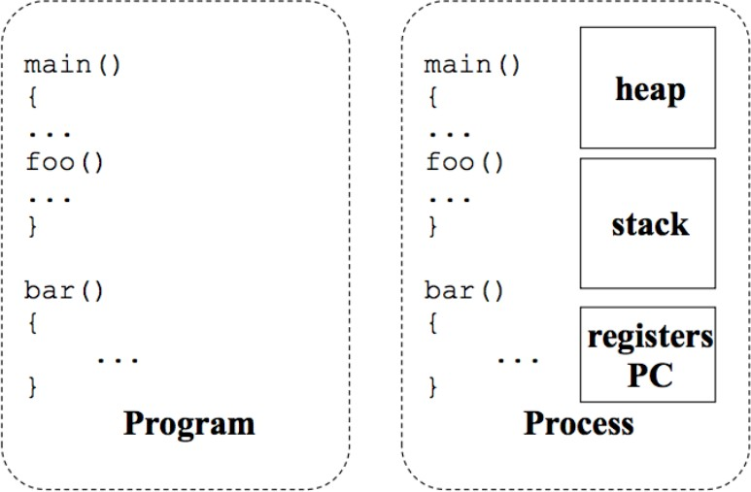
Program and Processes
Figure: Program vs Process
UFCFWK-15-2 (UWE)

Slide 23
